Slide 1
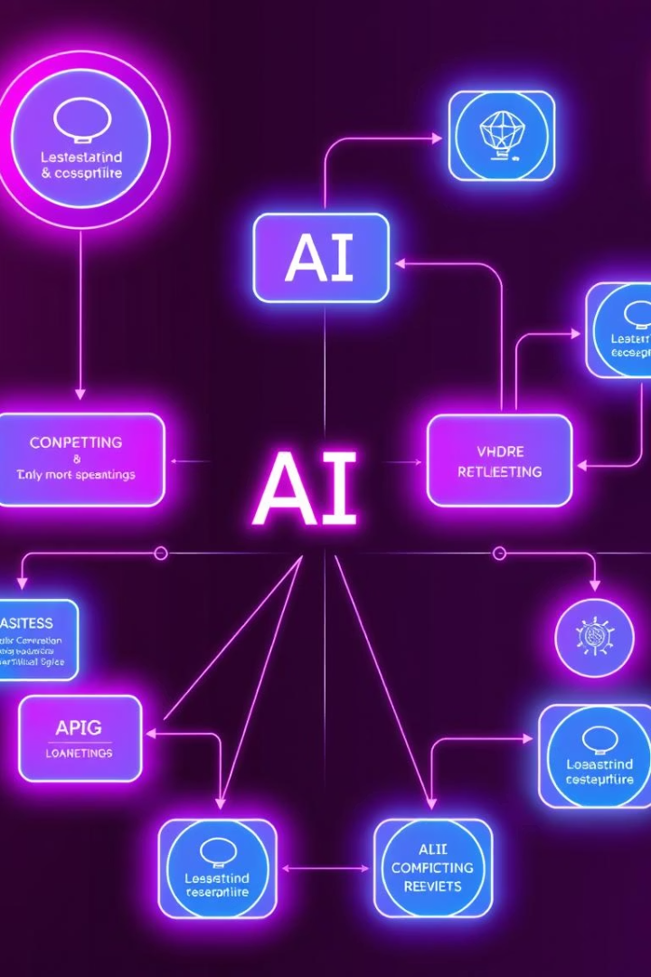
Hybrid AI Orchestration: LangGraph & LangChain
Hybrid AI orchestration model combining LangGraph and LangChain to optimize workflow control and AI logic integration. We will cover key features, comparisons, and the execution model that delivers robust, stateful, and scalable conversational AI systems.

Slide 2
LangChain vs LangGraph: Architectural Comparison
Feature
LangChain
LangGraph
Workflow Orchestration
Limited; chaining functions with conditionals
Native FSM-style orchestration using directed graph
State Management
Rudimentary; flat memory objects
Built-in persistent state across nodes, scoped and clean
Branching / Conditional Routing
Difficult and prone to bugs
Explicit conditional transitions between nodes
Retry / Fallback
Manual implementation required
Native retry/fallback support in each node
Multistep Forms
Complex prompt engineering
Natural fit: each form step is a node
Action-based UI Integration
Needs custom logic
Easier to model per-action nodes and transitions
Tooling Ecosystem
Rich and mature
Can integrate LangChain tools inside nodes
Debugging & Visualization
Difficult, requires logging
Graph visualizers for flow inspection
Learning Curve
Simple to start
Steeper but more scalable
Maturity / Ecosystem
Mature, big community
Newer, evolving, but stable

Slide 3

Final Recommendation: Hybrid Approach
We recommend using LangGraph as the core orchestration framework to manage workflow, state, and retries. Embed LangChain tools and components inside LangGraph nodes where AI processing is needed. This hybrid approach leverages the strengths of both platforms for scalable, maintainable conversational AI.
LangGraph
Manages flow control, stateful transitions, and error handling natively.
LangChain
Handles AI logic, prompt templates, and model interactions inside nodes.

Slide 4
Why LangGraph?
Natural FSM Layout
Modular Nodes
Supports inProgress vs complete flags and conditional edge transitions for clear state management.
Each node can perform Tachyon model calls with prompt formatting and plug in LangChain prompts.
Native retry logic handles failures gracefully, ensuring robustness.
UI actions like Revise or Confirm are declaratively handled with node transitions.

Slide 5



Hybrid Model: Best of Both Worlds
LangGraph
Acts as the flow controller managing FSM, retries, state, and control logic.
LangChain
Embedded inside nodes to provide prompt templates, model chains, and memory management.

Slide 6
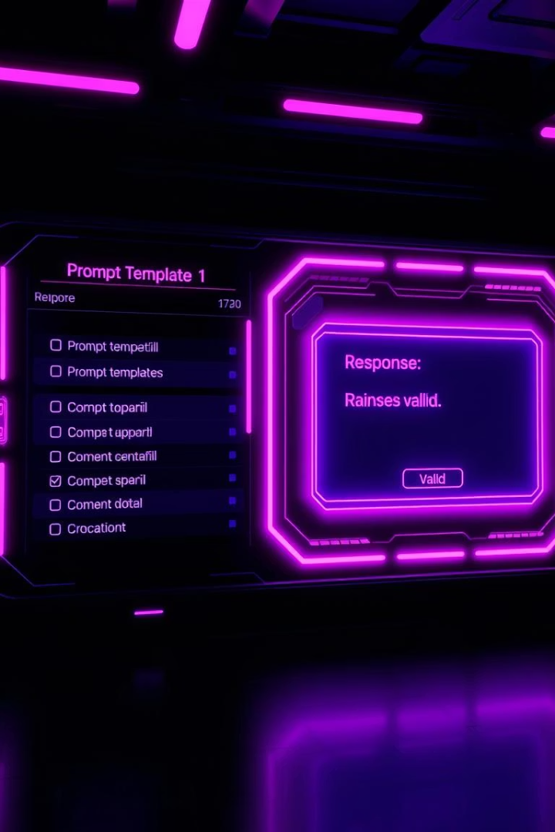
LangChain: AI Logic and Model Interface
Prompt Formatting
Uses templates to create conversation history-aware prompts before model calls.
Model Invocation
Calls LLMs via Tachyon using LangChain’s LLMChain and custom chains.
Response Checking
Filters outputs for flags, extracts answers, and formats responses.
Retry Handling
Detects poor responses and triggers prompt reformulation or fallback flows.

Slide 7
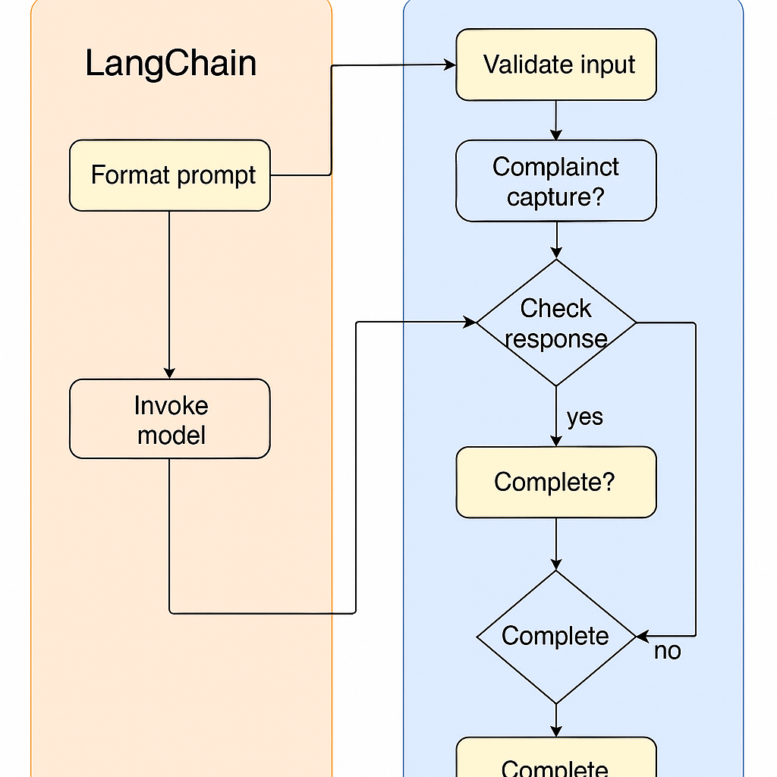
Execution Model: How It Works
LangGraph initiates the flow and manages state transitions. When AI reasoning is required, it passes state to LangChain, which builds prompts, calls the model, and returns structured responses.
LangGraph then decides whether to retry, mark the session complete, or proceed to the next action. This hybrid model combines clean orchestration with powerful AI logic abstraction for reliable conversational AI.

